Slide 1

Sideband search, Peasoup and Pruning
Wei Cheng
26.02.21

Slide 2
Sideband search

Slide 3
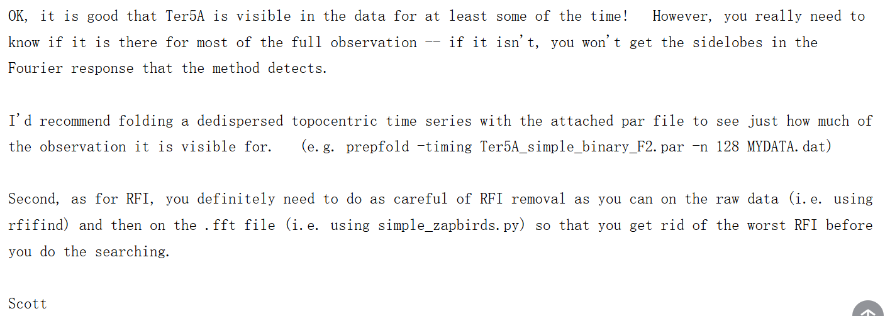
Email with Scott Ransom:
Visible for the full observation
RFI mitigation

Slide 4
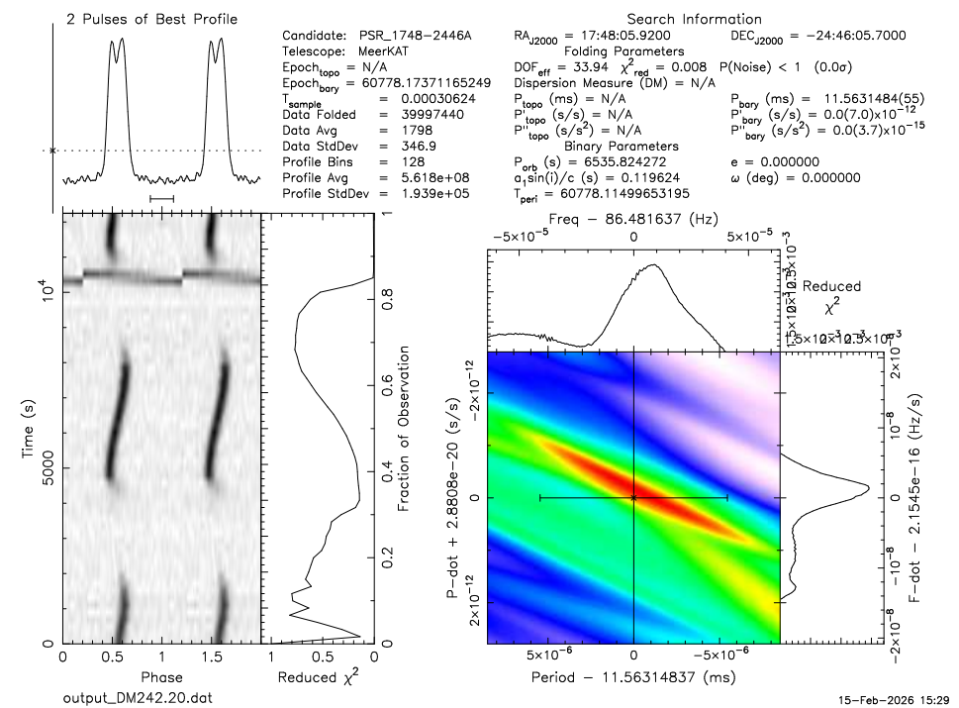
For Ter5A:
RFI：
There is very strong RFI in the time domain.
2. Vacuum：
Ter5A is eclipsed by its companion star.

Slide 5
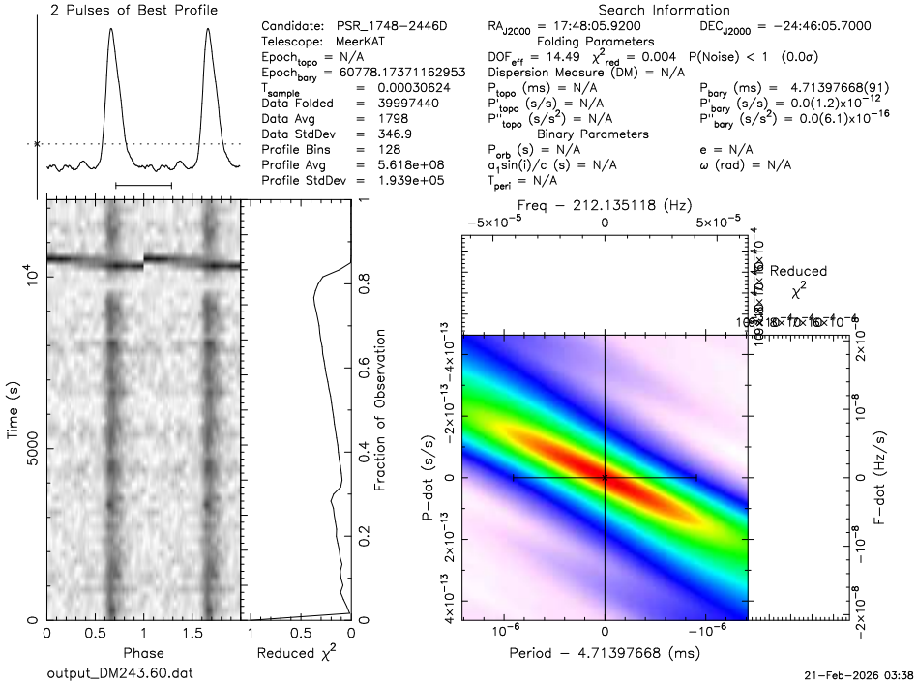
For Ter5D:

Slide 6
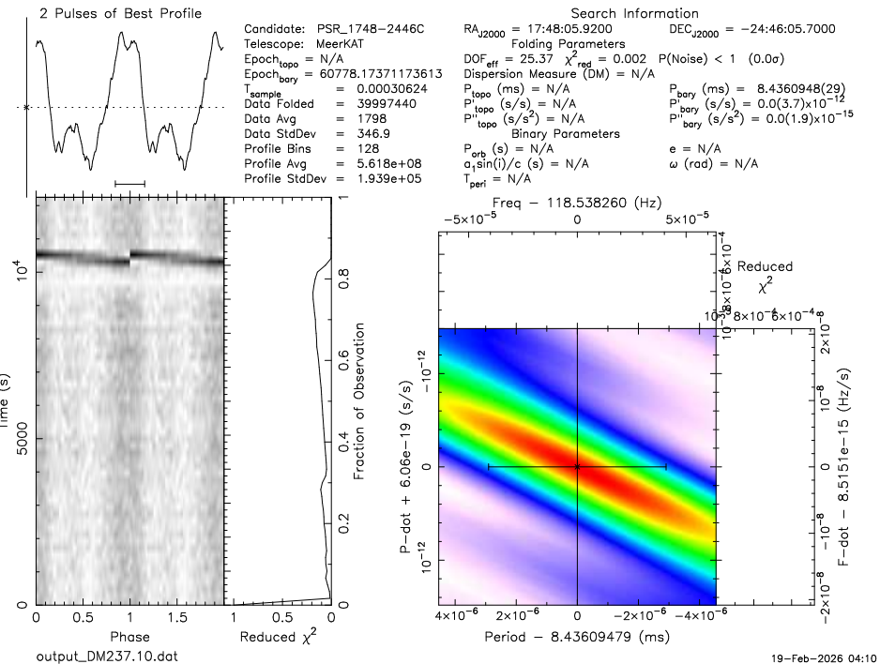
For Ter5C:

Slide 7
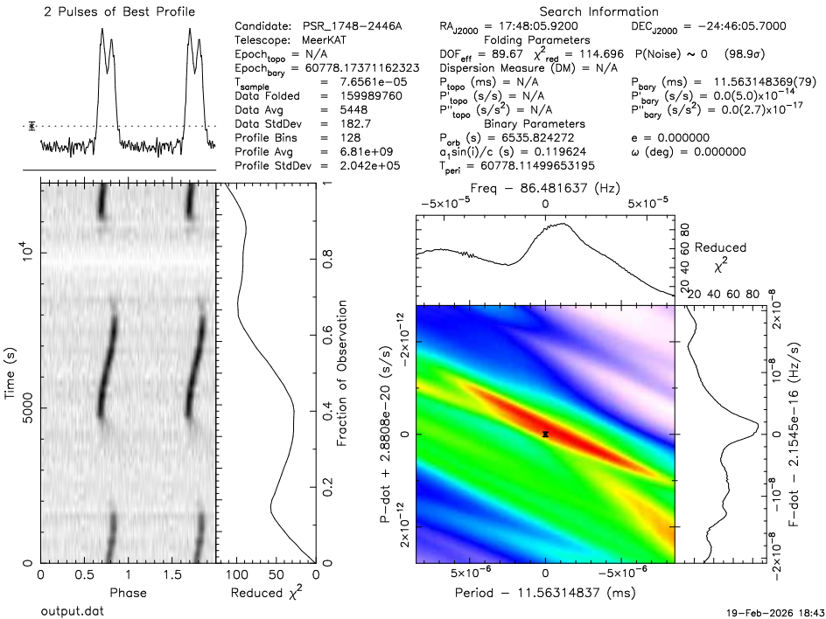
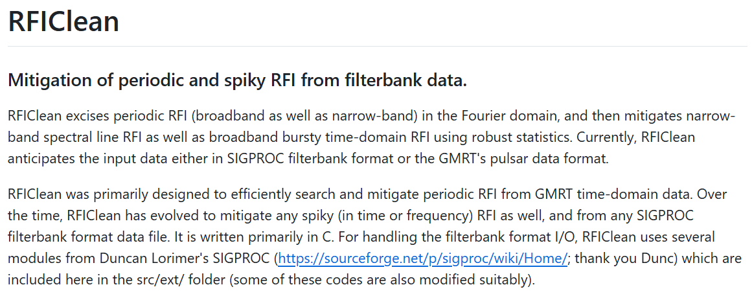
RFI mitigation:
Without RFI
With RFI

Slide 8
RFI mitigation:

Slide 9
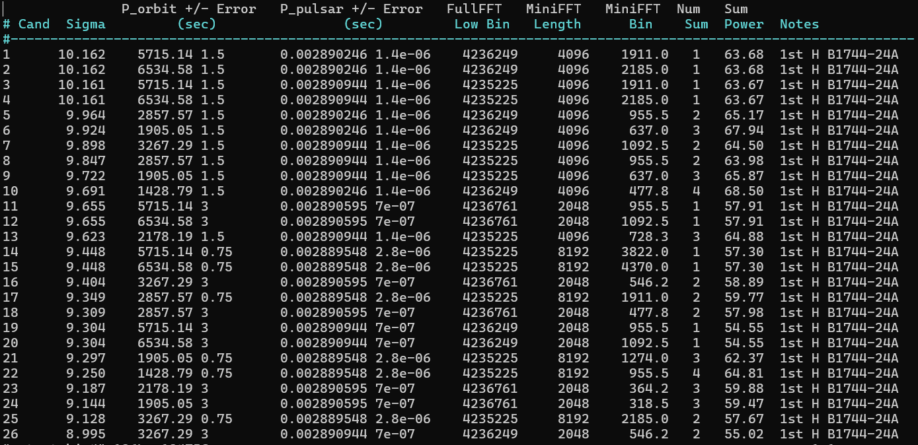
11.56ms 4th harmonic
Sideband search:

Slide 10
Peasoup

Slide 11
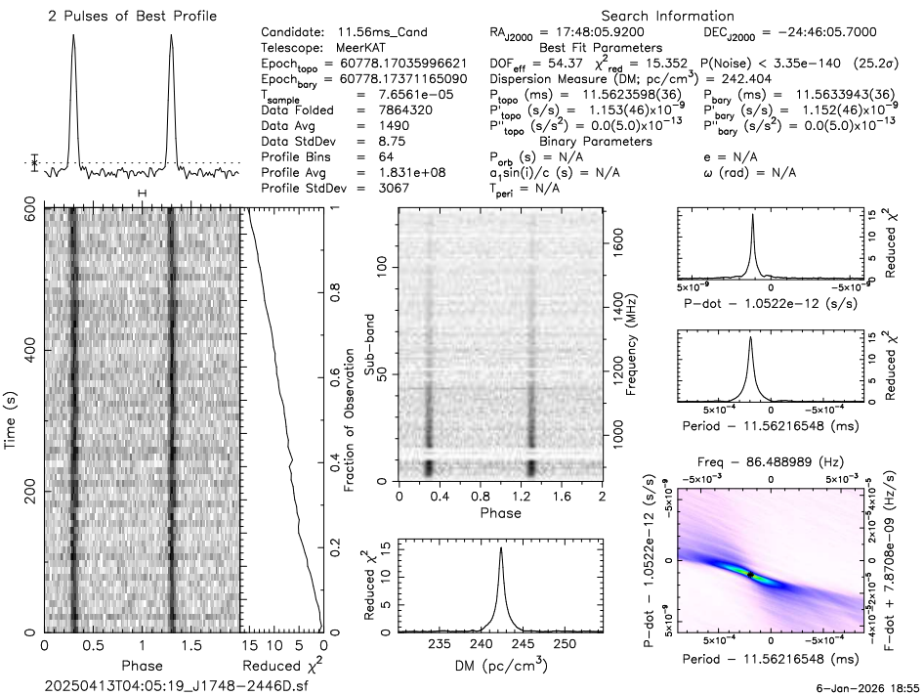
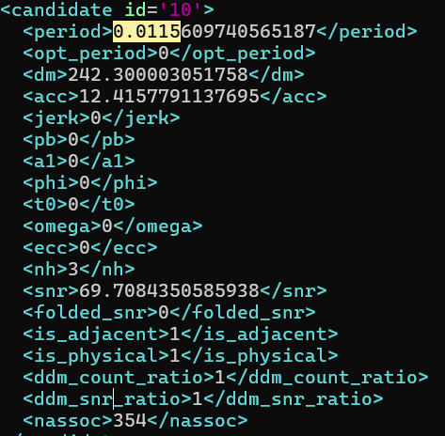
Acceleration search for Ter5A:
10m data

Slide 12
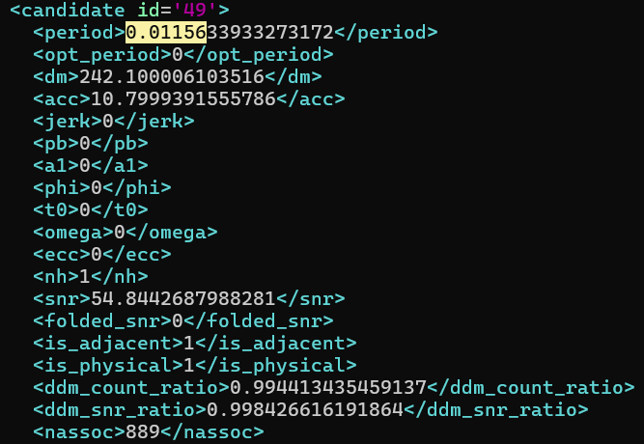
Acceleration search for Ter5A:
60m data

Slide 13
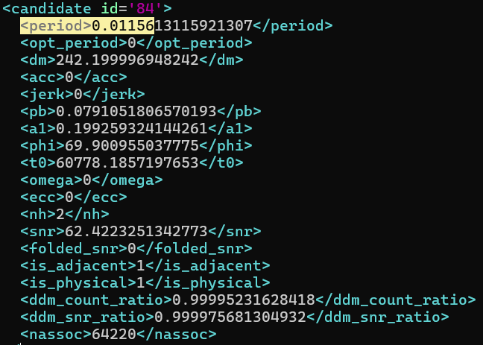
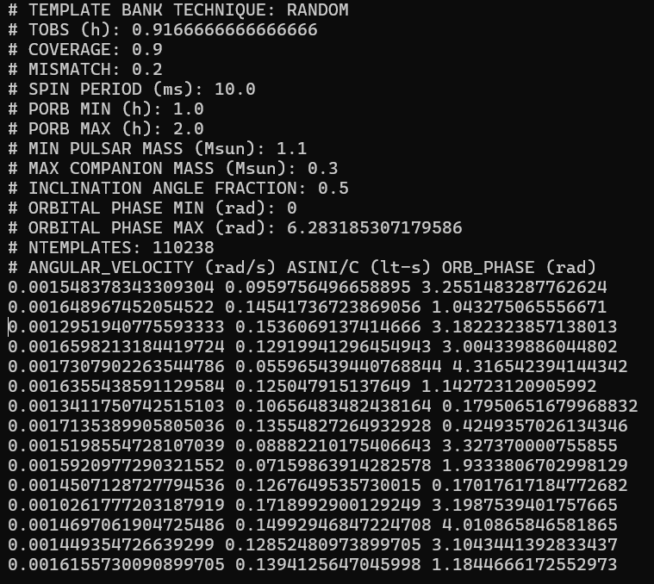

Circular search for Ter5A:
$$P_{b} = 0.079105 d \sim 114 m$$
Template bank

Slide 14
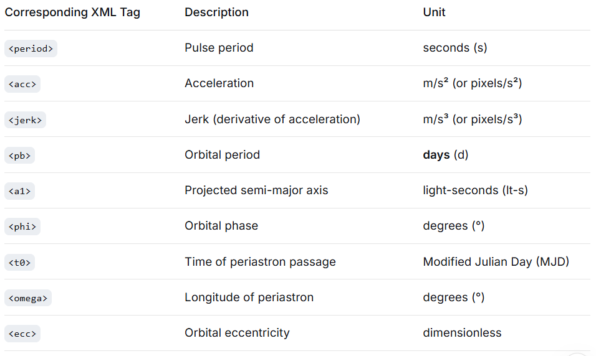
Output parameters:

Slide 15

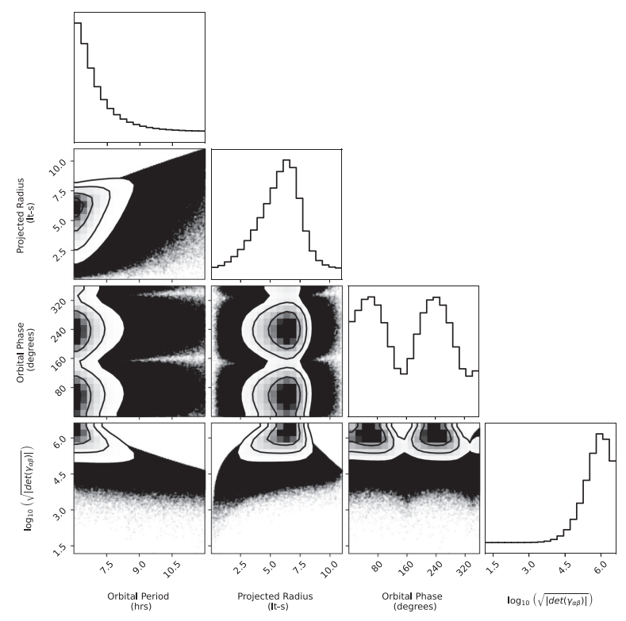

Template bank search:
1.Move near a fixed point in the parameter space and calculate the match at different positions;
2.Adjust the number of templates based on the match;
3.Generate templates based on the adjustment and perform matching.

Slide 16
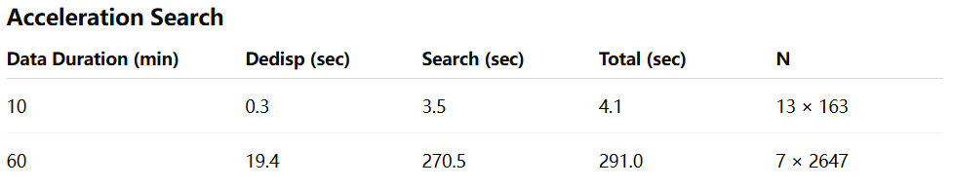
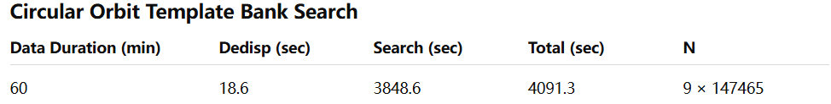
Time cost:

Slide 17
Dspsr and polarization

Slide 18
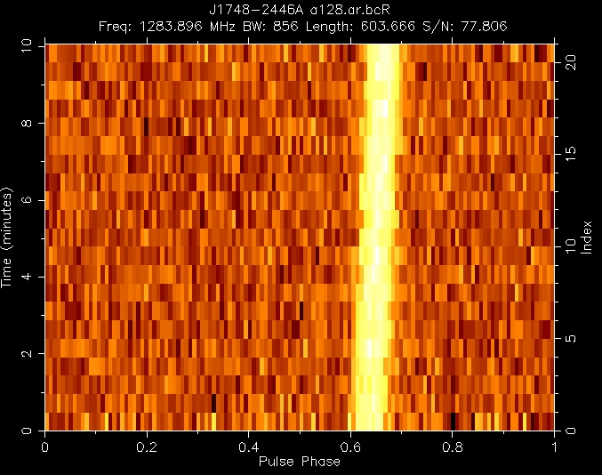
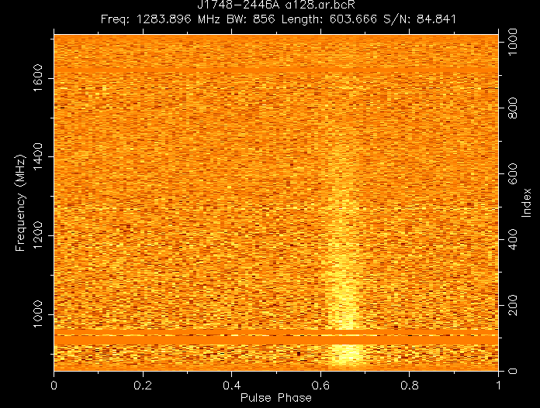
Ter5 A:
(1)time vs phase
(2)frequency vs phase

Slide 19
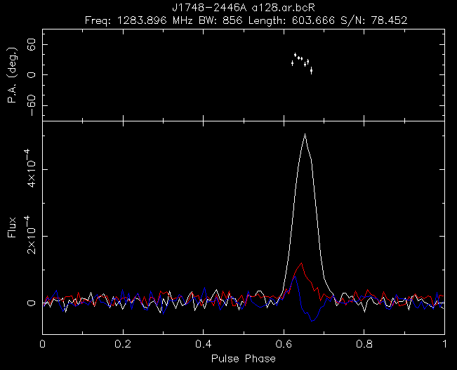
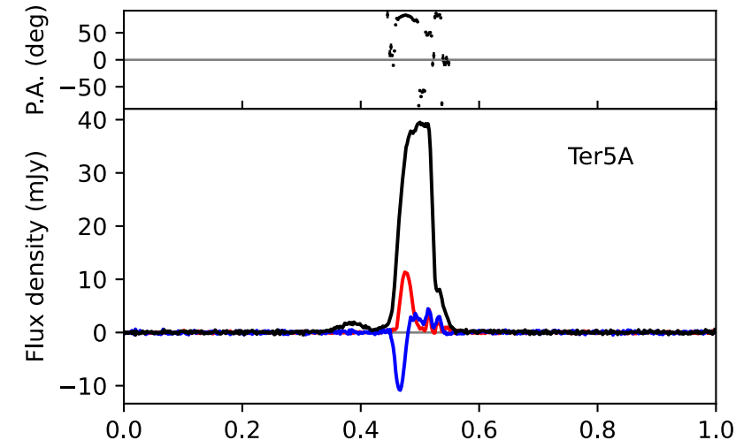
Ter5 A:
Polarization from Martsen et al.,2022
Polarization from DSPSR

Slide 20
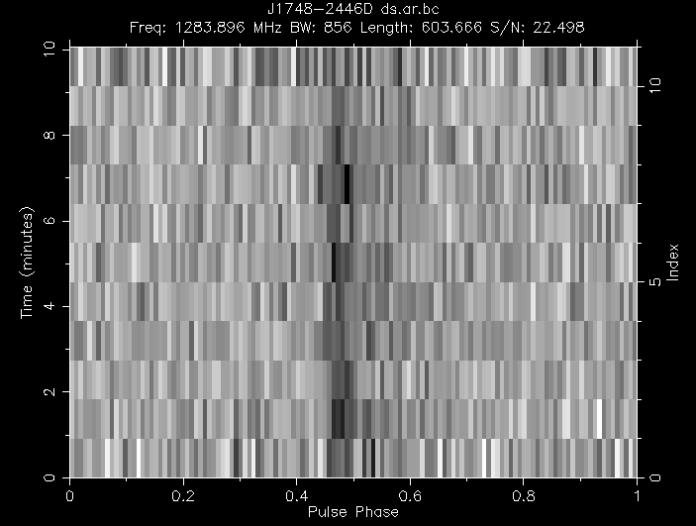
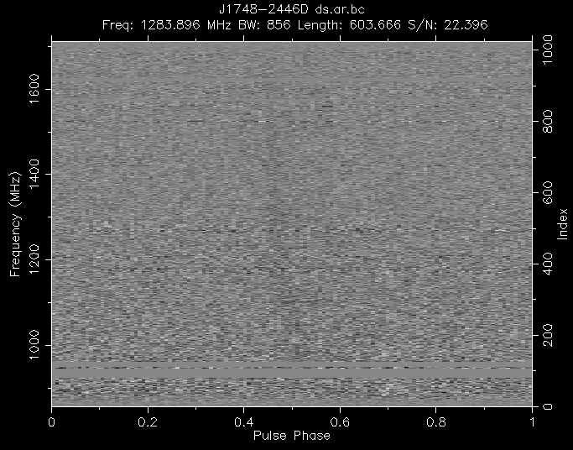
Ter5 D:
(1)time vs phase
(2)frequency vs phase

Slide 21
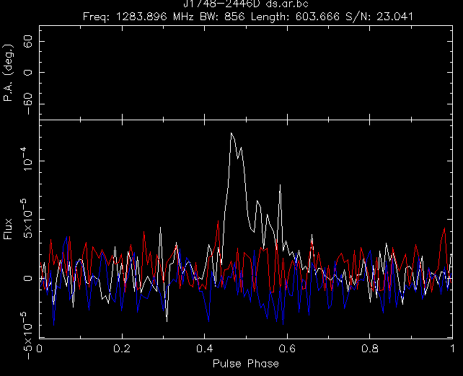
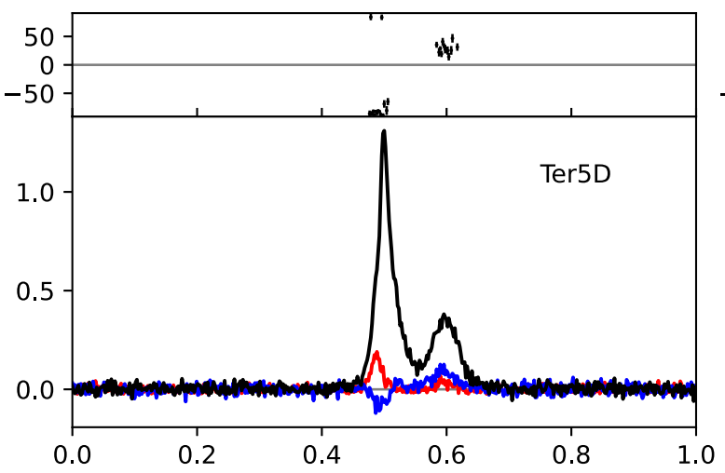
Ter5 D:
Polarization from Martsen et al.,2022
Polarization from DSPSR

Slide 22
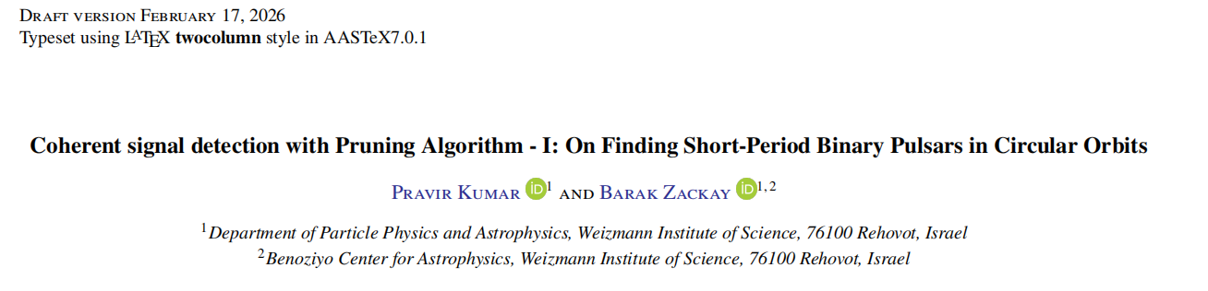
Pruning

Slide 23
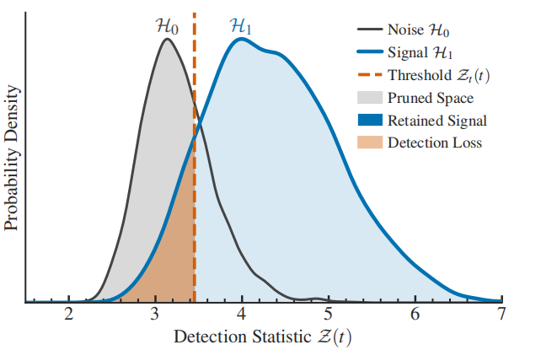

Basic concept:
They think that the evolution paths of noise and real signal SNR are different. As time increases and the signal-to-noise ratio (SNR) accumulates, the two will separate.
Starting from the smallest segment where noise and signal can be separated, an intermediate threshold is set. Candidates below this threshold are discarded, while those with high signal-to-noise ratios are retained for further subsequent searching.

Slide 24
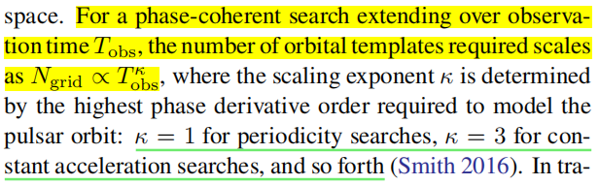
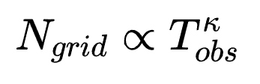
Basic concept:

Slide 25
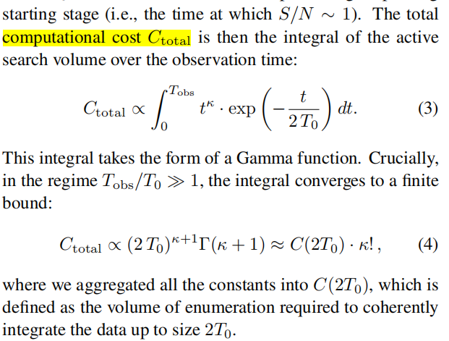
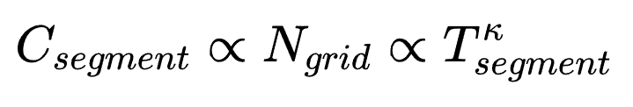
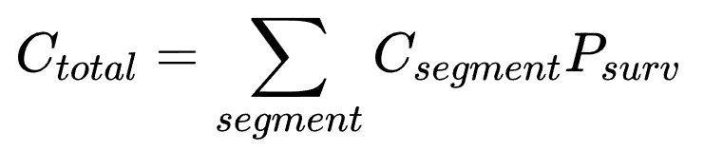
Basic concept:
For every stage without pruning, computational cost:
And the survival possibility:
So total computational cost:

Slide 26
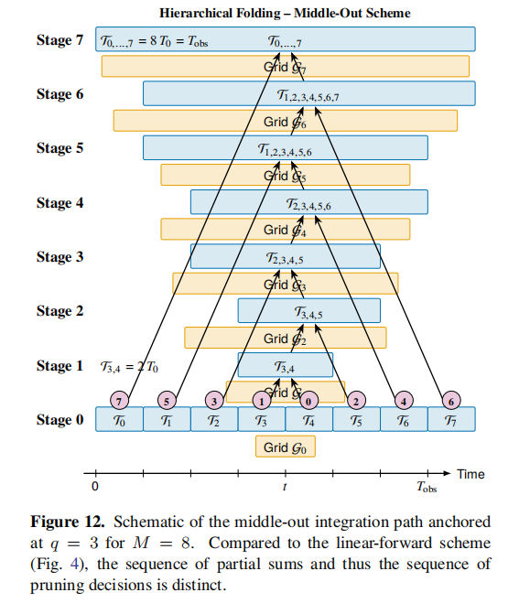


Coherent combine:
The search operation is performed only on the most basic segments. Subsequent calculations reuse the results from these basic segments and perform coherent combination on them.
And at each stage, an SNR threshold is set and pruning is performed.

Slide 27
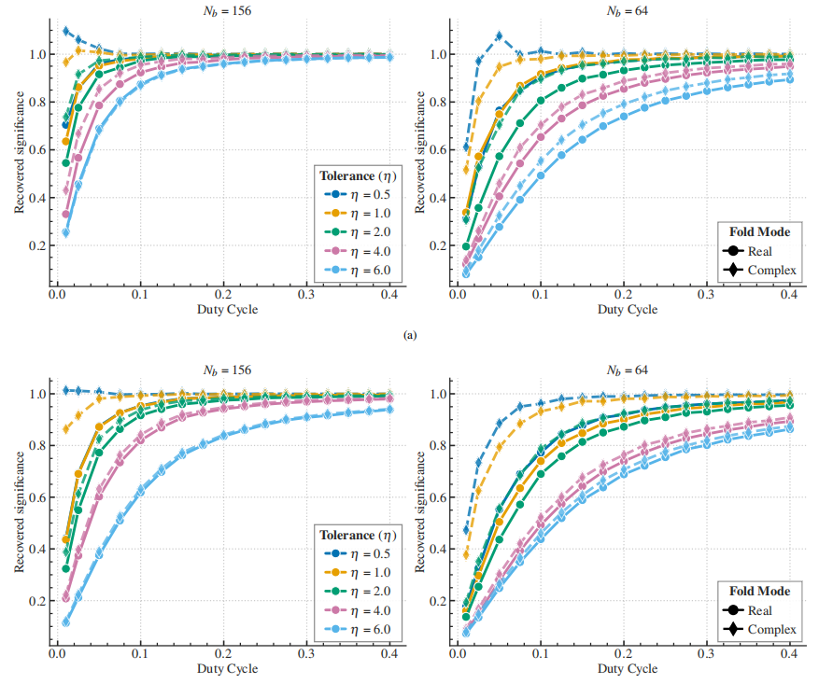
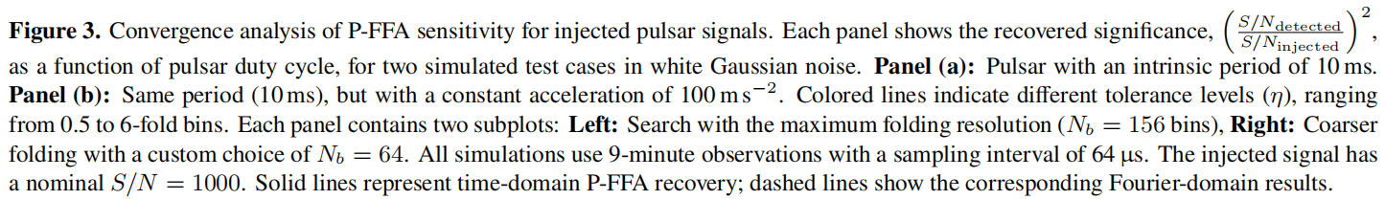
Basic concept:

Slide 28
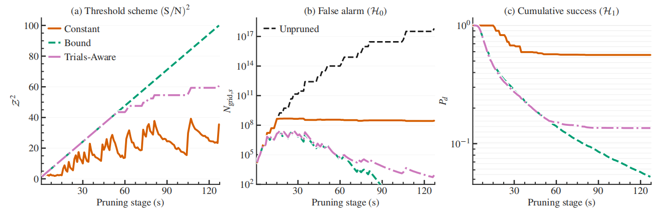
Comparasion:
Here, results comparing with other methods are not presented yet; only a comparison of the number of remaining candidates with and without pruning is shown.

Slide 29
Advantage:
1.Narrow Pulse Optimization:
Uses Fourier-domain folding instead of time-domain binning, significantly eliminating quantization noise.
2.Drastically Reduced Computation:
Employs an extreme pruning(EP) strategy to eliminate unpromising candidates at each stage, reducing computational cost compared to template bank algorithms like Peasoup.
3.Long-Duration Coherent Coverage:
This method achieves coherent integration over a full orbital period, offering far greater precision than sideband searches and with less computational cost comparedd to template bank algorithms.

